Slide 1
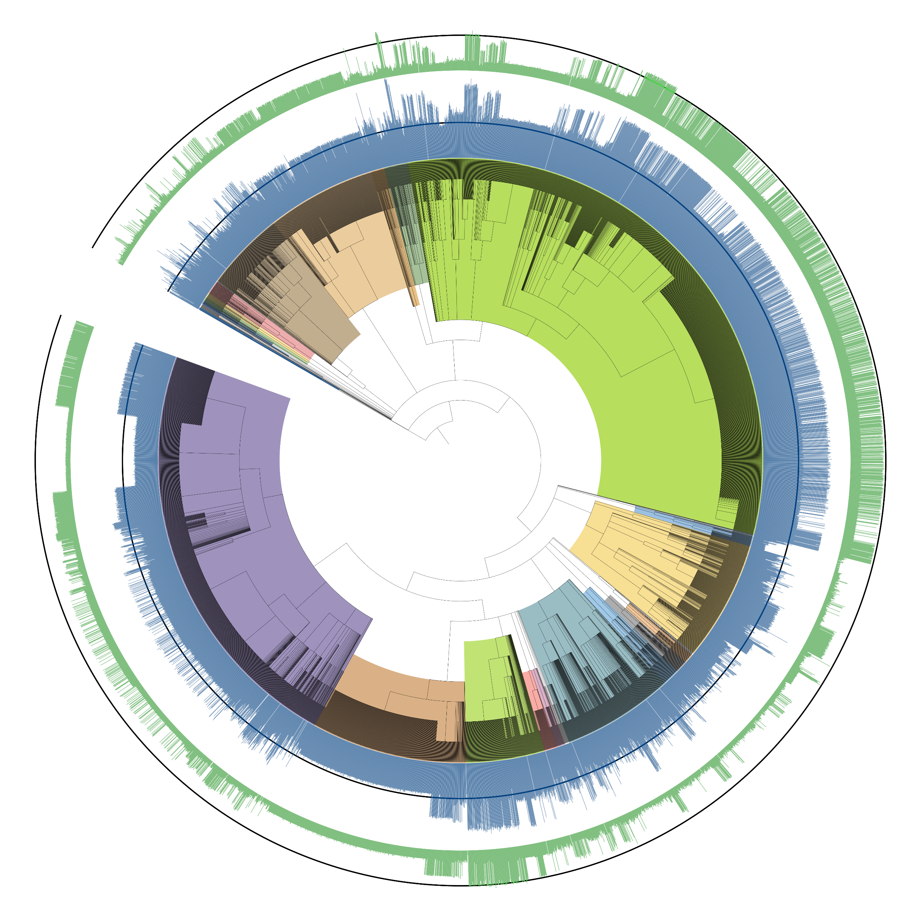
400
0
*Campylobacterota
*Betaproteobacteria
400
0
*Synergistota
*Alphaproteobacteria
*Gammaproteobacteria
*Thermodesulfobacteriota
*Spirochaeta
*Bacteroidota
*Fusobacteriota
*Archaea
*Lactobacillales
*Mycoplasmatota
*Actinomycetota
*Negativicutes
*Clostridia
*Erysipelotrichia
*Tissierellia
*Bacillaceae
*Staphylococcaceae
*Listericeae
*Paenibacillceae
# of blocked reactions in AGORA2
# of blocked reactions post gap filling

Slide 2
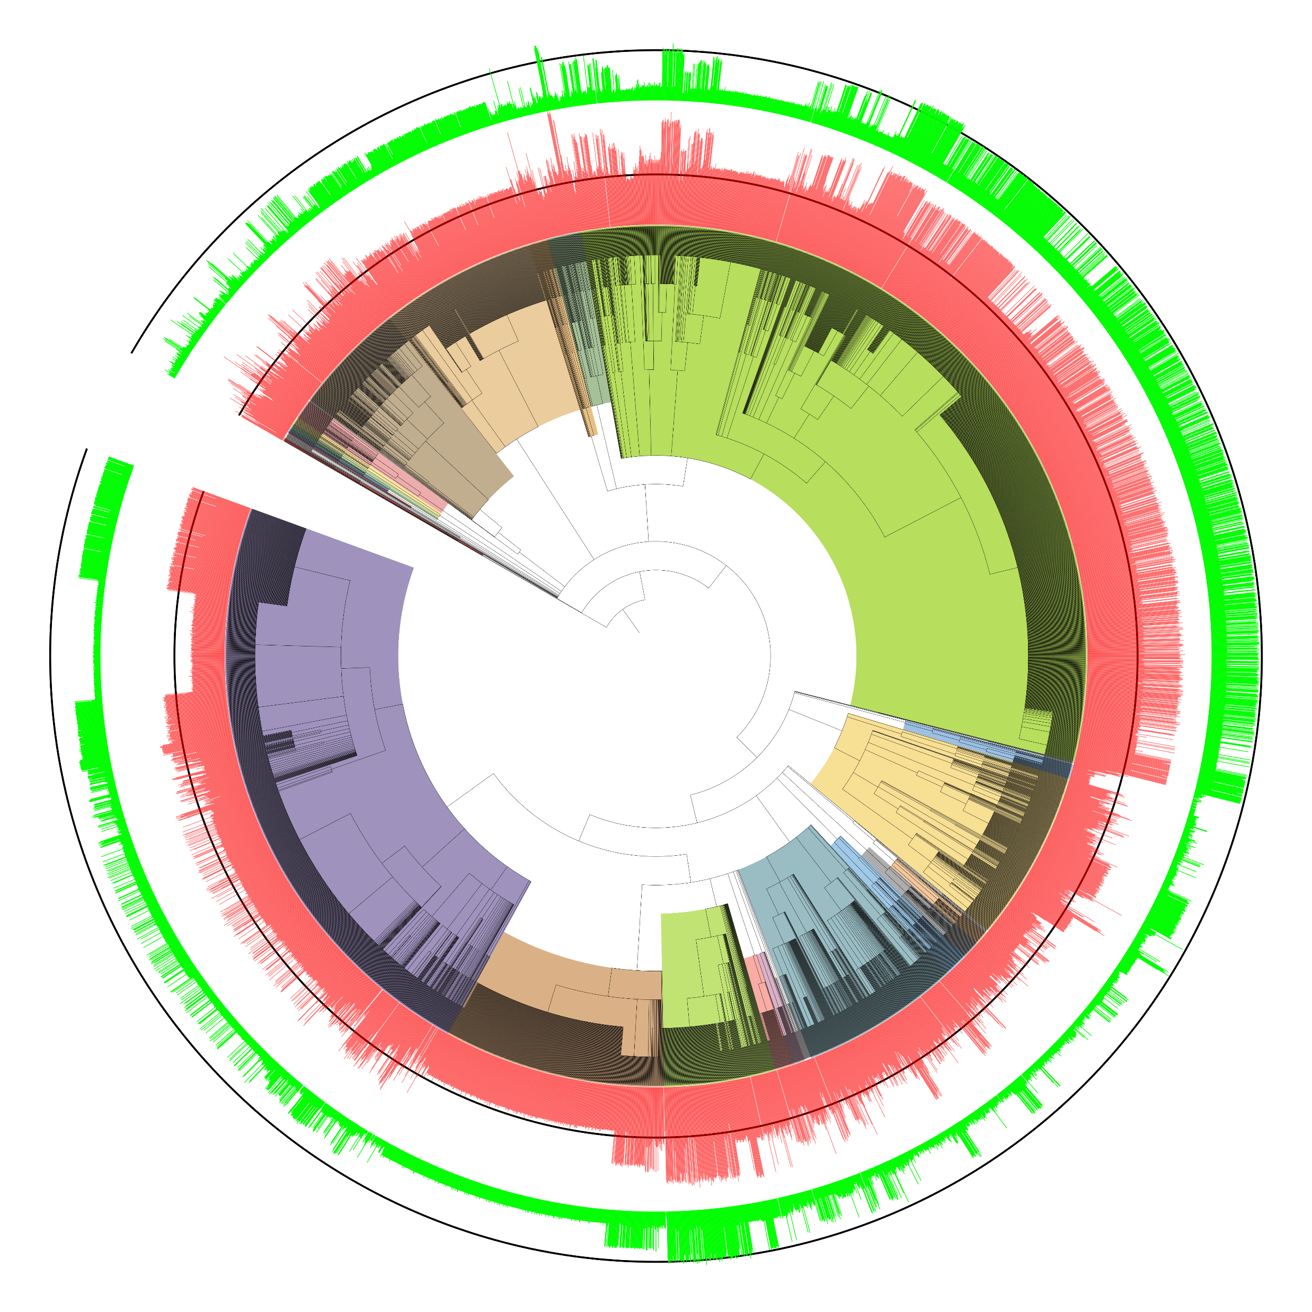
400
0
*Campylobacterota
*Betaproteobacteria
400
0
*Synergistota
*Alphaproteobacteria
*Gammaproteobacteria
*Thermodesulfobacteriota
*Spirochaeta
*Bacteroidota
*Fusobacteriota
*Archaea
*Lactobacillales
*Mycoplasmatota
*Actinomycetota
*Negativicutes
*Clostridia
*Erysipelotrichia
*Tissierellia
*Bacillaceae
*Staphylococcaceae
*Listericeae
*Paenibacillceae

